Slide 1
Bayesian inference in neural networks
Psychology 209 Jan 11, 2018

Slide 2
Perception as inference
What objects, words, and letters are present in a scene?
Often all elements of evidence are inconclusive – yet as a whole correct perception is inevitable
Other times, we can increase our chance of being correct, but can’t completely ensure we will always be correct

Slide 3
Key ideas – 1
Bayes’ formula provides a basis for a theory of perceptual inference
This theory is quite general but depends on having a lot of knowledge
Any number of alternative hypotheses
Any number of elements of evidence
Sometimes we can relate this knowledge to a ‘generative model’ of the process that produced the evidence. Even when we cannot, the concept of a generative model is a useful one for understanding perceptual inference.

Slide 4
Probability of cancer given a positive mammogram?
The probability of a positive mammogram given breast cancer is .9
The probability of a positive mammogram given no breast cancer is .05
What else do we need to know to calculate p(Cancer|Positive Mammogram)?
The probability of breast cancer in the population of adult women is .001 (one woman in one-thousand has breast cancer)
Which number below is closest to is the probability of cancer given a positive mammogram?
(a) .9 (b) .2 (c) .01

Slide 5

A generative model for letter perception
Experiment:
I present some features to you – what letter do you think these features represent?
Generative Model:
A letter is chosen according to some distribution.
Features are chosen conditionally independently based on the letter.
Some features are hidden from view.

Slide 6
Bayesian calculations

Slide 7
Some observations
Odds ratios don’t change when we add or remove alternatives
p(h_{i}|e)/p(h_{j}|e) is unaffected by the number of other hypotheses
For example: In our case, p(A|e)/p(H|e) should stay constant independent of the number of other possible letter alternatives, if ratios of their base rates p(A)/p(H) don’t change
Common factors cancel out
For example, when p(h_{i}) is the same for all letters, p(h_{i}) cancels out of p(h_{i}|e)
Likewise, evidence supporting a pair of alternatives equally doesn’t affect p(h_{i}|E)/p(h_{j}|e)
For example, we could remove some of the features on which A and H agree, and p(A|e)/p(H|e) would be unaffected

Slide 8
Key Ideas – 2
Real neural networks can perform perceptual inferences, and combine information in ways that are consistent with Bayesian approaches
Artificial neural networks rely on computations that allow these processes to be modeled
There are fairly simple linking assumptions that make it reasonably straightforward to see how one simulates the other even though the correspondences are abstract
Deep learning models such as CNN’s use these computations, at least to compute the final estimates of probabilities

Slide 9
Salzman Newsome experiment
Stimuli consisted of fields of random dots moving in one of eight different directions
Coherence of dots varies across trials of the experiment
There’s also an electrode in the Monkey’s brain, providing pseudo-evidence for motion in a particular direction

Slide 10
Basic results
Bias visible at low coherence when there’s no microstimulation
Visual stimulus effect dominates at high coherence
Electrical stimulation dominates at low coherence
All have effects at intermediate coherence
Plotted points indicate p(monkey chose indicated direction) without microstim (open dots) or with microstim (filled dots). In both conditions, the eight possible directions were presented at the indicated coherence level equally often.

Slide 11
Bayesian calculations

Slide 12
Logarithmic transformation of Bayesian inference
Using logs¹:
Then applying the softmax function:
p(h_{i})|e) = exp(log(S_{i}))/(Σ_{i’}exp(log(S_{i’})))
Is equivalent to the Bayesian computation previously described
¹Unless otherwise indicated, log is the natural log in neural network research

Slide 13
Simple neural network that estimates posterior probabilities
Input units for different elements of evidence
a_{j} = 1 if present, 0 if absent
Bias weights
b_{i} = log(p_{i}/c) where c is any constant
Connection weights
w_{ij} = log(p(e_{j}|h_{i})/c) where c is any constant
Net input
net_{i} = b_{i} + Σ_{j} a_{j} w_{ij}
Softmax makes activation correspond to posterior probability

Slide 14
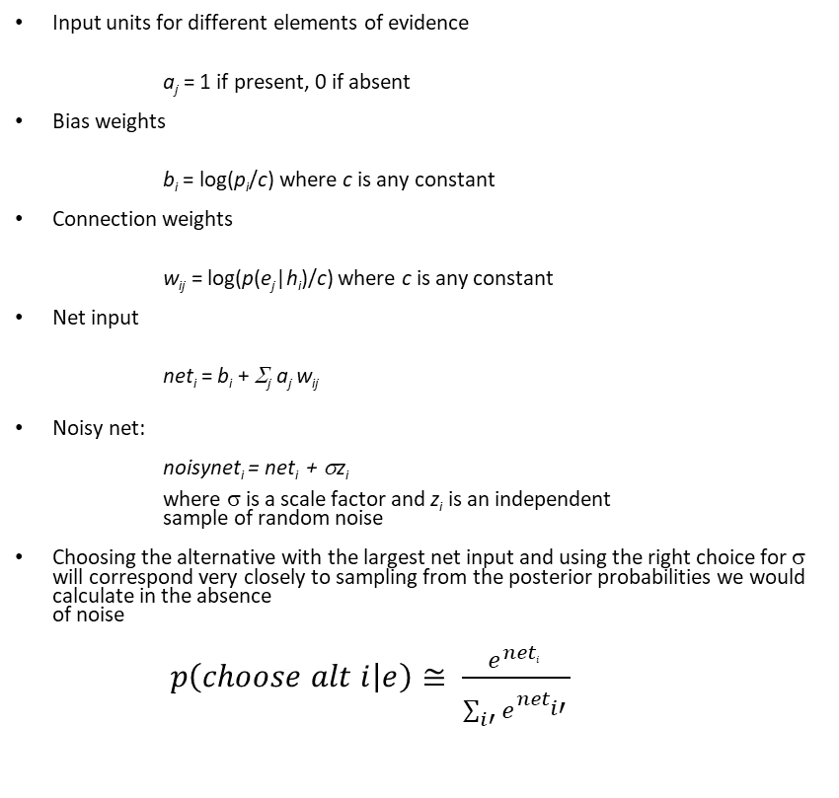
Simple neural network that samples posterior probabilities
Input units for different elements of evidence
a_{j} = 1 if present, 0 if absent
Bias weights
b_{i} = log(p_{i}/c) where c is any constant
Connection weights
w_{ij} = log(p(e_{j}|h_{i})/c) where c is any constant
Net input
net_{i} = b_{i} + Σ_{j} a_{j} w_{ij}
Noisy net:
noisynet_{i} = net_{i} + σz_{i} where σ is a scale factor and z_{i} is an independent sample of random noise
Choosing the alternative with the largest net input and using the right choice for σ will correspond very closely to sampling from the posterior probabilities we would calculate in the absence of noise
$p\left(choose alt i | e\right)≅ \frac{e^{{net}_{i}^{}}}{\sum_{i′}{e^{{net}_{i′}^{}}}}$

Slide 15
Fit to Salzman Newsome data
Data (dashed lines) pooled from conditions in which both visual and electrical stimulus affected behavior
Top panel: data and fits when VS and ES were 135 degrees apart
Bottom panel: data and fit of model when VS and ES were 90 degrees apart
Weights and biases estimated using logistic regression to find best fit
Neural networks perform an advanced version of logistic regression when they learn
Top shows animals are not just averaging the two kinds of input, although the effect approximates averaging when the two sources of evidence point in similar directions (bottom)

Slide 16
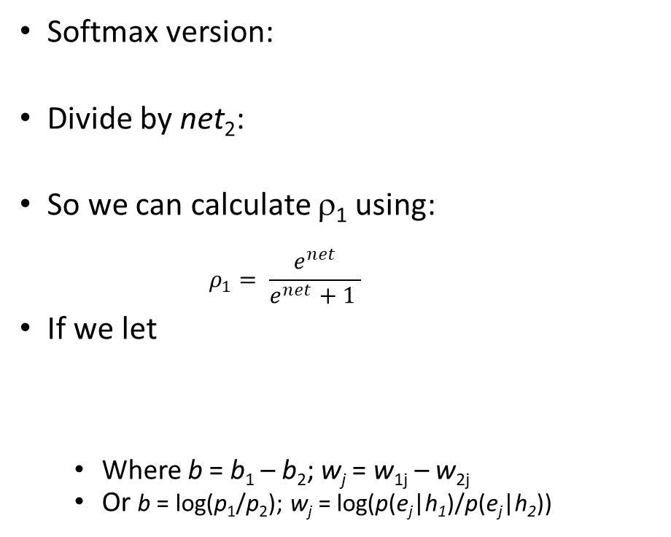
Using just one unit where there are only two alternatives
Softmax version:
Divide by net₂:
So we can calculate ρ₁ using:
$$ρ_{1}= \frac{e^{net}}{e^{net}+1 }$$
If we let
Where b = b₁ – b₂; w_{j} = w_{1j} – w_{2j}
Or b = log(p₁/p₂); w_{j} = log(p(e_{j}|h₁)/p(e_{j}|h₂))
Data (points) and fits (lines) to an experiment on phoneme identification with varying auditory and visual support for ‘BA’ and ‘DA’

Slide 17
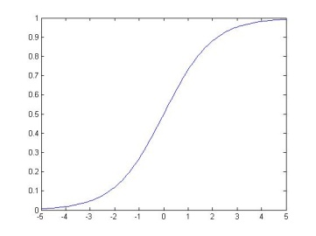
Input and activation of units in PDP models
Biologically inspired form of unit update:
In simulations this seems to work well to sample from the posterior
An activation function that links PDP models to Bayesian ideas more explicitly:
max=1
Input from unit j
a
w_{ij}
0
rest
min=-.2
unit i
a_{i} or p_{i}
net_{i}

Slide 18
Neural and conceptual descriptions

Slide 19
Relationships between units and neurons
Simple case: units correspond to explicit hypotheses
You can think that several actual neurons are dedicated to each explicit hypothesis or element of evidence – this can help guide intuitions
More interesting case: neural activity patterns correspond to hypotheses – individual neurons participate in the activity associated with many different hypotheses
Today and next time we stay closer to the simple case
But we must understand this as a useful simplification, not as an assumption about the true underlying state of affairs

Slide 20
Useful concepts linking neural networks and probabilistic inference
Unit: hypothesis placeholder
A unit is not a neuron!
Log prior: bias
Log(p(e_{j}|h_{i})) = w_{ij}
Log p(e|h): summed synaptic input
Logit: log of support: net input = bias + summed synaptic input
Estimate of posterior: activation
Maximizing under noise can approximate probability matching
Degree of noise corresponds to scale factor 1/T in softmax function
This allows performance to be completely random when noise dominates, or completely deterministic when there is no noise.

Slide 21
Next time and homework
In general a percept corresponds to an ensemble of hypotheses that are mutually interdependent
We will see next time how the entire state of a hierarchical neural network can correspond to a coherent ensemble of hypotheses…
This allows us to begin to account for our ability to experience percepts that we don’t have dedicated individual neurons for
Do the small homework before you do the reading for next time so that you are on solid ground as you read the second half of the paper!

